Slide 1
Dynamic Itemset Counting and implication Rules for Market Basket Data

Slide 2




Authors
Shalom Tsur
Sergey Brin
Rajeev Motwani
Jeffrey D. Ullman

Slide 3
Training data set: Buys_computer

Slide 4
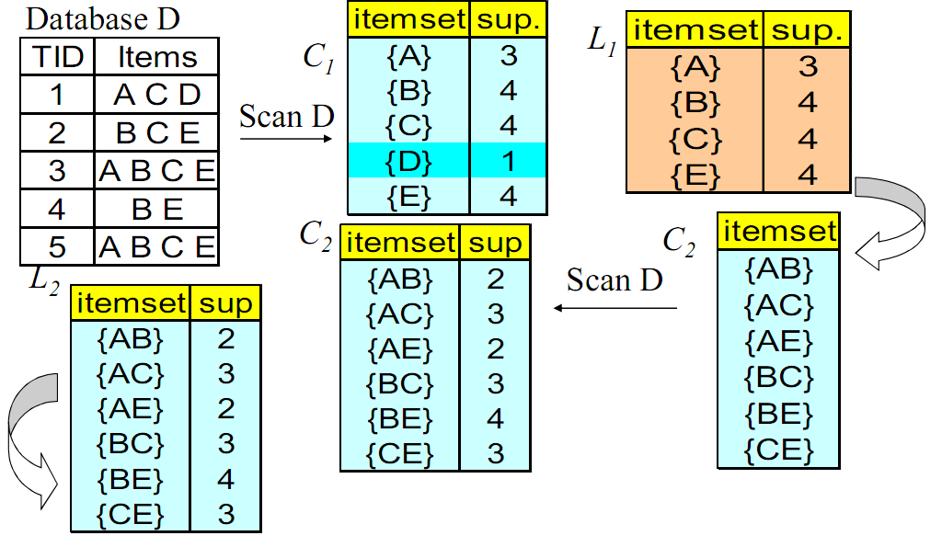
Frequent itemset generation
count all items
Apriori
count all items

Slide 5
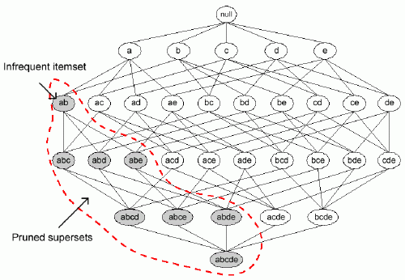
Frequent itemset generation
Apriori
count
count
count
4 passes
count

Slide 6
Frequent itemset generation
A
B
count
count
count
4 passes
AB
count
Why do we have to wait til the end of the pass?
DIC allows us to start counting an itemset as soon as we suspect it may be necessary to count it.

Slide 7
Dynamic Itemset Counting(DIC)
For example:
Input: 50,000 transactions
Given constant M = 10,000
1-itemsets
10,000 transactions
10,000 transactions
10,000 transactions
10,000 transactions
10,000 transactions
2-itemsets
3-itemsets
4-itemsets
< 2 passes

Slide 8
Apriori vs DIC
1-itemsets
2-itemsets
3-itemsets
4-itemsets
10,000 transactions
10,000 transactions
10,000 transactions
10,000 transactions
10,000 transactions
4 passes
< 2 passes
Apriori
DIC

Slide 9
DIC Algorithm
Itemsets are marked in 4 different ways :
Solid box: confirmed large itemset
Solid circle: confirmed small itemset
Dashed box: suspected large itemset
Dashed circle: suspected small itemset

Slide 10
Pseudocode Algorithm
SS = φ // solid square (frequent)
SC = φ // solid circle (infrequent)
DS = φ // dashed square (suspected frequent)
DC = { all 1-itemsets } // dashed circle (suspected infrequent)
while (DS != 0) or (DC != 0) do begin
read M transactions from database into T
forall transactions t Є T do begin
// increment the respective counters of the itemsets marked with dash
for each itemset c in DS or DC do begin
if ( c Є t ) then
c.counter++ ;

Slide 11
Pseudocode Algorithm
for each itemset c in DC
if ( c.counter ≥ threshold ) then
move c from DC to DS ;
if ( any immediate superset sc of c has all of its subsets in SS or DS ) then
add a new itemset sc in DC ;
end
for each itemset c in DS
if ( c has been counted through all transactions ) then
move it into SS ;
for each itemset c in DC
if ( c has been counted through all transactions ) then
move it into SC ;
end
end
Answer = { c Є SS } ;

Slide 12
DIC Algorithm
min_sup= 2 (=20%) , M = 5
TID | Items
1 | a b d e
2 | b c d
3 | a b d e
4 | a c d e
5 | b c d e
6 | b d e
7 | c d
8 | a b c
9 | a d e
10 | b d
TID | a | b | c | d | e
1 | 1 | 1 | 0 | 1 | 1
2 | 0 | 1 | 1 | 1 | 0
3 | 1 | 1 | 0 | 1 | 1
4 | 1 | 0 | 1 | 1 | 1
5 | 0 | 1 | 1 | 1 | 1
6 | 0 | 1 | 0 | 1 | 1
7 | 0 | 0 | 1 | 1 | 0
8 | 1 | 1 | 1 | 0 | 0
9 | 1 | 0 | 0 | 1 | 1
10 | 0 | 1 | 0 | 1 | 0

Slide 13
DIC Algorithm
abcde
Start of DIC algorithm
abcd
abce
abde
acde
bcde
abc
abd
abe
acd
ace
ade
bcd
bce
bde
cde
ab
ac
ad
ae
bc
bd
be
cd
ce
de
a
b
c
d
e
a=0, b=0, c=0, d=0, e=0
{}
Mark the empty itemset with a solid square.
Mark all the 1-itemsets with dashed circles.
Leave all other itemsets unmarked.

Slide 14
DIC Algorithm
While any dashed itemsets remain:
1. Read M transactions. For each transaction, increment the respective counters for the itemsets that appear in the transaction and are marked with dashes.
min_sup= 2 , M = 5
TID | Items
1 | a b d e
2 | b c d
3 | a b d e
4 | a c d e
5 | b c d e
6 | b d e
7 | c d
8 | a b c
9 | a d e
10 | b d
abcde
After M transactions
abcd
abce
abde
acde
bcde
abc
abd
abe
acd
ace
ade
bcd
bce
bde
cde
ab
ac
ad
ae
bc
bd
be
cd
ce
de
a
b
c
d
e
a=3, b=3, c=3, d=5, e=4
{}

Slide 15
DIC Algorithm
2. If a dashed circle's count exceeds minsupp, turn it into a dashed square. If any immediate superset of it has all of its subsets as solid or dashed squares, add a new counter for it and make it a dashed circle.
min_sup= 2 , M = 5
TID | Items
1 | a b d e
2 | b c d
3 | a b d e
4 | a c d e
5 | b c d e
6 | b d e
7 | c d
8 | a b c
9 | a d e
10 | b d
abcde
After M transactions
abcd
abce
abde
acde
bcde
abc
abd
abe
acd
ace
ade
bcd
bce
bde
cde
ab
ac
ad
ae
bc
bd
be
cd
ce
de
a
b
c
d
e
{}
a=3,b=3,c=3,d=5,e=4
,ab=0,ac=0,ad=0,…,de=0
Notes:
Immediate superset /
Has all sebsets

Slide 16
DIC Algorithm
3. If a dashed itemset has been counted through all the transactions, make it solid and stop counting it.
TID | Items
1 | a b d e
2 | b c d
3 | a b d e
4 | a c d e
5 | b c d e
6 | b d e
7 | c d
8 | a b c
9 | a d e
10 | b d
min_sup= 2 , M = 5
abcde
After 2M transactions
abcd
abce
abde
acde
bcde
abc
abd
abe
acd
ace
ade
bcd
bce
bde
cde
ab
ac
ad
ae
bc
bd
be
cd
ce
de
a
b
c
d
e
{}
a=3+2=5, b=3+3=6, c=3+2=5, d=5+4=9, e=4+2=6,ab=1,ac=1,ad=1,
ae=1,bc=1,bd=2,be=1,cd=1,ce=0,de=2
a=3,b=3,c=3,d=5,e=4,ab=0,ac=0,ad=0,…,de=0
Notes:
(ไม่มี)Immediate superset /
Has all sebsets

Slide 17
DIC Algorithm
4. If we are at the end of the transaction file, rewind to the beginning.
5. If any dashed itemsets remain, go to step 1
TID | Items
1 | a b d e
2 | b c d
3 | a b d e
4 | a c d e
5 | b c d e
6 | b d e
7 | c d
8 | a b c
9 | a d e
10 | b d
min_sup= 2 , M = 5
abcde
After 3M transactions
abcd
abce
abde
acde
bcde
abc
abd
abe
acd
ace
ade
bcd
bce
bde
cde
ab
ac
ad
ae
bc
bd
be
cd
ce
de
a
b
c
d
e
{}
ab=3,ac=2,ad=4,ae=4,bc=3,bd=5,be=4,cd=4,ce=2,de=6
ab=1,ac=1,ad=1,ae=1,bc=1,bd=2,be=1,cd=1,ce=1,de=2
, abc=0,abd=0,abe=0,…,cde=0
Notes:
Immediate superset /
Has all sebsets

Slide 18
DIC Algorithm
TID | Items
1 | a b d e
2 | b c d
3 | a b d e
4 | a c d e
5 | b c d e
6 | b d e
7 | c d
8 | a b c
9 | a d e
10 | b d
min_sup= 2 , M = 5
abcde
After 4M transactions
abcd
abce
abde
acde
bcde
abc
abd
abe
acd
ace
ade
bcd
bce
bde
cde
ab
ac
ad
ae
bc
bd
be
cd
ce
de
a
b
c
d
e
{}
abc=1,abd=0,abe=0,acd=0,ace=0,ade=1,bcd=0,bce=0,
bde=1,cde=0
abc=0,abd=0,abe=0,acd=0,ace=0,ade=0,bcd=0,bce=0,
bde=0,cde=0
Notes:
()Immediate superset /
Has all sebsets

Slide 19
DIC Algorithm
TID | Items
1 | a b d e
2 | b c d
3 | a b d e
4 | a c d e
5 | b c d e
6 | b d e
7 | c d
8 | a b c
9 | a d e
10 | b d
min_sup= 2 , M = 5
abcde
After 5M transactions
abcd
abce
abde
acde
bcde
abc
abd
abe
acd
ace
ade
bcd
bce
bde
cde
ab
ac
ad
ae
bc
bd
be
cd
ce
de
a
b
c
d
e
{}
abc=1,abd=2,abe=2,acd=1,ace=1,ade=4,bcd=2,bce=0,
bde=3,cde=2
abc=1,abd=0,abe=0,acd=0,ace=0,ade=1,bcd=0,bce=0,
bde=1,cde=0
, abde=0
Notes:
()Immediate superset /
Has all sebsets

Slide 20
DIC Algorithm
TID | Items
1 | a b d e
2 | b c d
3 | a b d e
4 | a c d e
5 | b c d e
6 | b d e
7 | c d
8 | a b c
9 | a d e
10 | b d
min_sup= 2 , M = 5
abcde
After 6M transactions
abcd
abce
abde
acde
bcde
abc
abd
abe
acd
ace
ade
bcd
bce
bde
cde
ab
ac
ad
ae
bc
bd
be
cd
ce
de
a
b
c
d
e
{}
abc=1,abd=2,abe=2,acd=1,ace=1,ade=4,bcd=2,bce=0,
bde=3,cde=2, abde=0
abde=0
Notes:
()Immediate superset /
Has all sebsets

Slide 21
DIC Algorithm
TID | Items
1 | a b d e
2 | b c d
3 | a b d e
4 | a c d e
5 | b c d e
6 | b d e
7 | c d
8 | a b c
9 | a d e
10 | b d
min_sup= 2 , M = 5
abcde
After 7M transactions
abcd
abce
abde
acde
bcde
abc
abd
abe
acd
ace
ade
bcd
bce
bde
cde
ab
ac
ad
ae
bc
bd
be
cd
ce
de
a
b
c
d
e
{}
abde=0
abde=2
Notes:
()Immediate superset /
Has all sebsets

Slide 22
Non-homogeneous Data
If data is non-homogeneous,
efficiency is tend to be decreased.
New item-sets for counting may come late.
A
A
A
B
B
B
AB
AB
AB
A
B
AB
A
B
AB
A
B
AB
With greater distribution, start count AB here.
Start count AB Here

Slide 23
Homogeneous Data
Solution : randomness.
Randomize order of how to read transactions.
Every pass must be the same order.
It may be expensive to do.

Slide 24
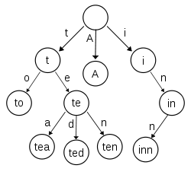
Data structure : Tries
Use tries for counting item-set.
Every node has counter.
The order of item-set affects efficiency
There is detail about how to reorder item-set in each transaction in paper.

Slide 25
Extension to DIC
Parallelism
Incremental Updates

Slide 26
Parallelism
Divide the database among the nodes and to have each node count all the itemsets for its own data segment
DIC can dynamically incorporate new itemsets to be added, it is not necessary to wait.
Nodes can proceed to count the itemsets they suspect are candidates and make adjustments as they get more results from other nodes

Slide 27
Incremental Updates
Handling incremental updates involves two things: detecting when a large itemset becomes small and detecting when a small itemset becomes large.
If a small itemset becomes large .We must count over the entire data, not just the update. Therefore, when we determine that a new itemset must be counted. we must go back and count it over the prefix of the data that we missed.

Slide 28
Incremental Updates
Old
Data
start
Updated
Data
Detect found Updated Data
must be counted

Slide 29
References
Brin, Sergey and Motwani, Rajeev and Ullman, Jeffrey D. and Tsur, Shalom, Dynamic Itemset Counting and Implication Rules for Market Basket Data: Project Final Report, 1997.
http://www2.cs.uregina.ca/~dbd/cs831/notes/itemsets/DIC.html

